Slide 1
ONLINE CITY TOUR GUIDE APPLICATION
PRESENTED BY
K.DURGA RAO

Slide 2
Index
Abstract
Existing System
Drawbacks Of Existing System
Proposed System
Features Of Proposed System
Modules
UML Diagrams
Forms
Software Requirements
Hardware Requirements
Conclusion

Slide 3
Abstract
City Tour Guide is provides the all the information about the cities.
It is very useful for the tourism system, in current tourism system, whenever a tourist visits famous spots, to know more about the place the hires a guide.
The hired guide then narrates history of the places.The proposed system doesn’t require a physical guide.
The mobile application installed on the user mobile then tourist can act as a guide.
This application contains the information about famous places like temples, parks, beaches and etc. The android based city guide system has more practical significance.

Slide 4
Existing System
In the existing system the details of the metro for different cities is available in different applications.
The user has to go around searching for the application that contains the details of the required city.
It is time consuming to search the details in this manner. Similarly details such as nearby hotels and hospitals are not available in a single application.

Slide 5
Disadvantages
Individual application for particular city.
Full version of application is paid one.
Needs internet connection for its accessing.
Finding the nearest hotel and hospital not possible.

Slide 6
Proposed System
The proposed system entitled as "City Tour Guide" is an online application". In the proposed system the details of the cities is shown in a single application.
It provides the famous location information of cities, and other details. The nearest hotels and the nearest hospitals for the particular place are shown to make the journey of the user easy.
It displays the Locations as per user's choice. In this proposed system user can act as a guide.
Users can access the information through on database. The software can record data in the database, display Cities information; Famous Places information, and many more.

Slide 7
Advantages
Major city details in a single application.
Complete online application.
Open source.
Searching facility.
Doesn’t require a physical guide.

Slide 8
Modules
Administration Module
Place Detection
Routing Module
Travelling Module
Rating Module

Slide 9
Module Description
Administration Module:
Administrator maintains the all the activities in this system. New changes are occurred those are maintained by the administrator.
Admin will have login form that can enter user name and password to view other features. After login is completed admin can Adding new places and deleting old places etc.

Slide 10
Module Description
Place Detection Module:
This module provides famous visiting places near to the selected location and also provides details about hotels, hospitals, shopping malls and so on.
User will be select the famous locations in this Module.

Slide 11
Module Description
Traveling Module:
This module provides the vehicular information, travels information, distance information, time and cost information to reach a place, sites those are used to select the vehicle and so on.

Slide 12
Module Description
Routing Module:
This module provides route information to the selected place.
The Route can display on the with in the using of GPS system.
User can easily trace the famous locations in this module.

Slide 13
Module Description
Rating Module:
In this module the users gives rating to the application.
Giving rating is stored to database.
Admin can see the this rating in database.

Slide 14
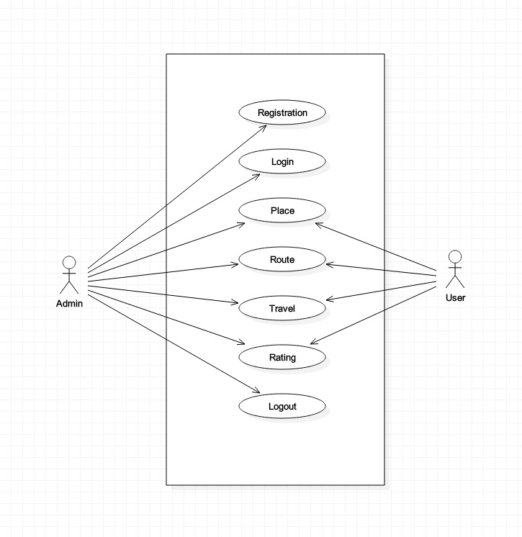
Use Case Diagram

Slide 15
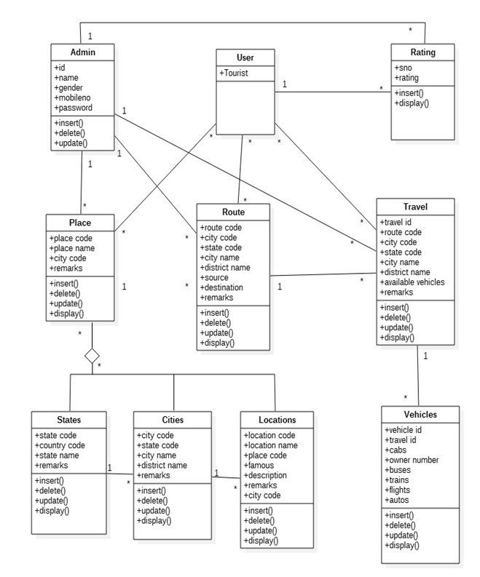
Class Diagram

Slide 16
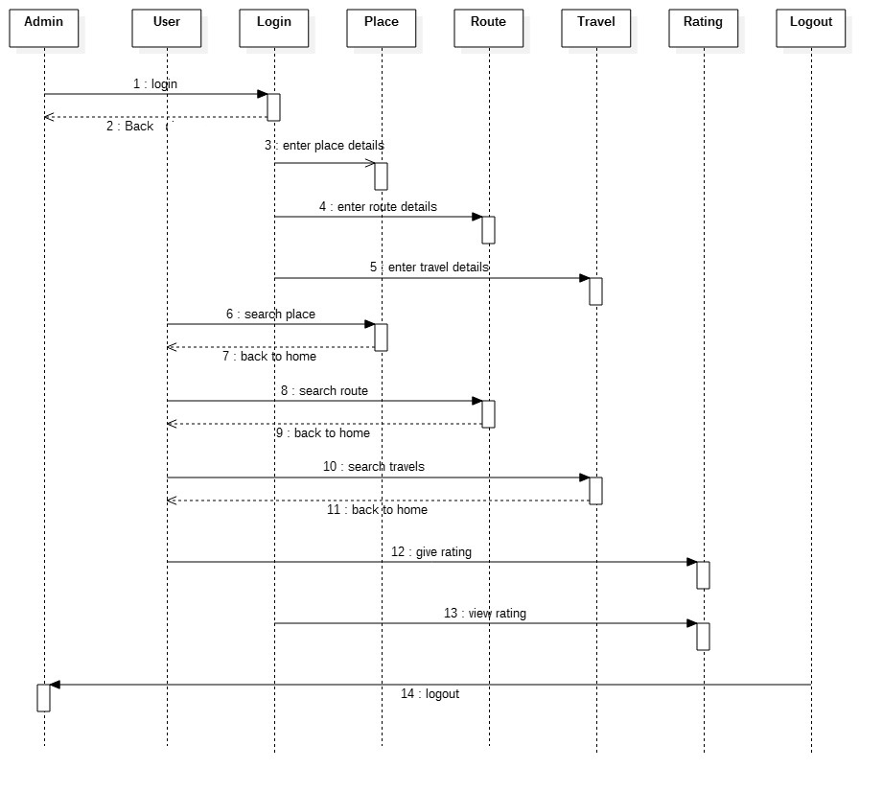
Sequence Diagram

Slide 17
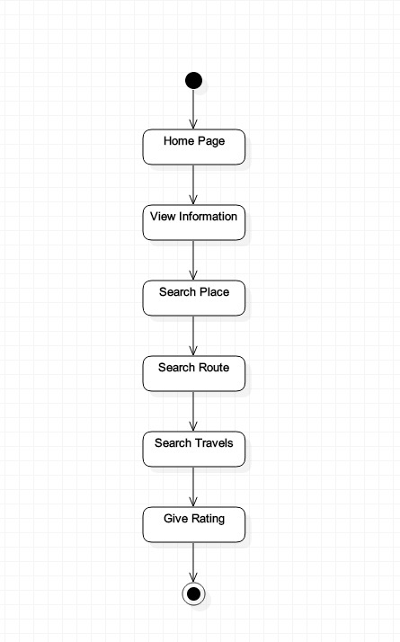
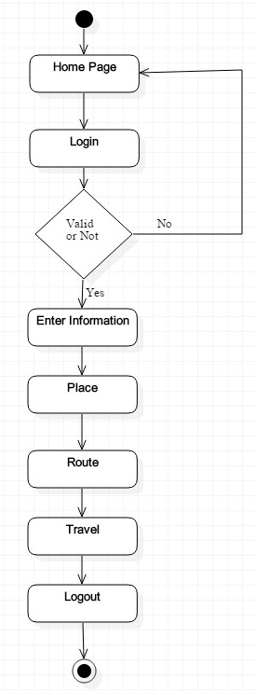
Activity Diagram

Slide 18
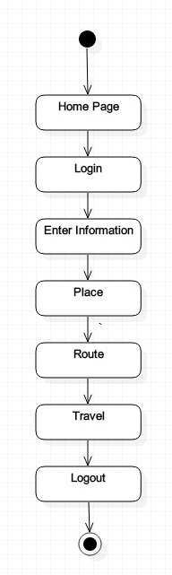
State Chart Diagram

Slide 19
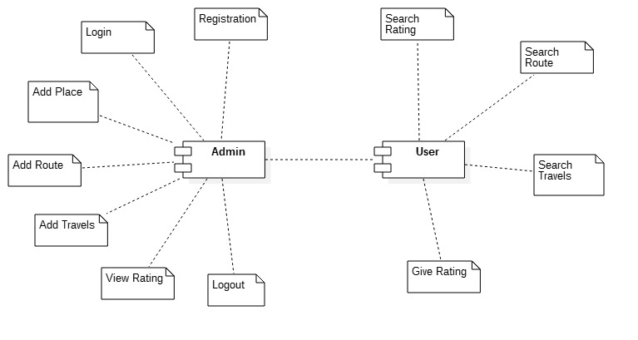
COMPONENT DIAGRAM

Slide 20
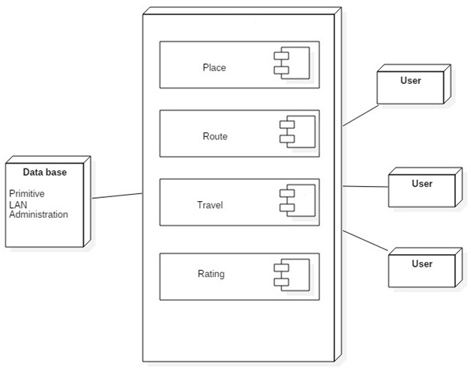
DEPLOYMENT DIAGRAM

Slide 21
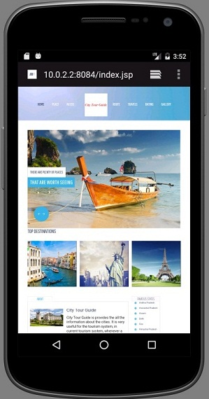
Home Page

Slide 22
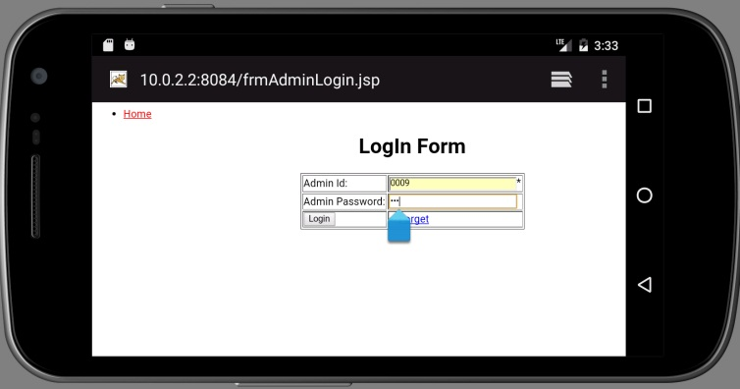
Admin Login Form

Slide 23
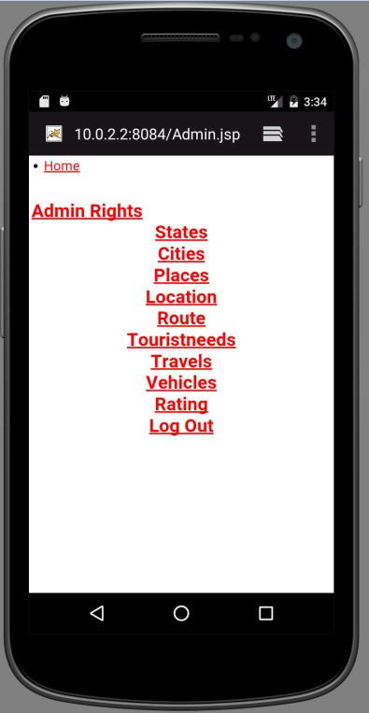
Home Page For Administration

Slide 24
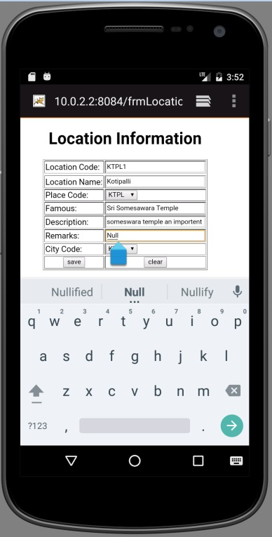
Data Insert Form

Slide 25
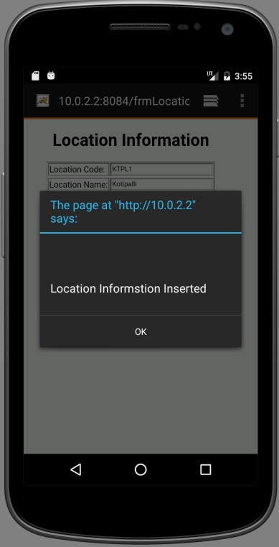
Data Insert Form

Slide 26
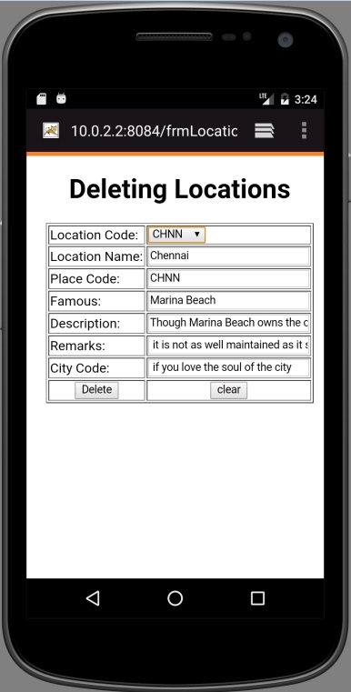
Data Delete Form

Slide 27
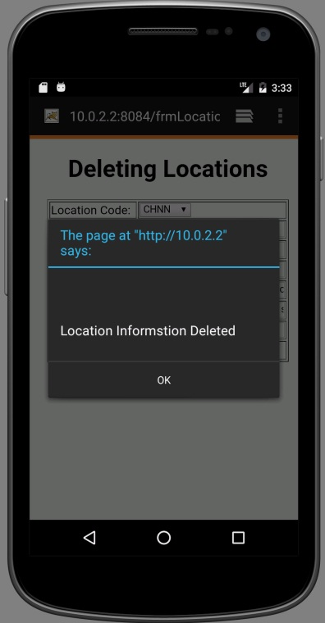
Data Delete Form

Slide 28
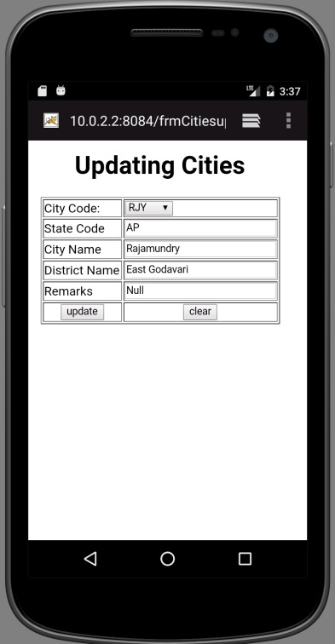
Data Update Form

Slide 29
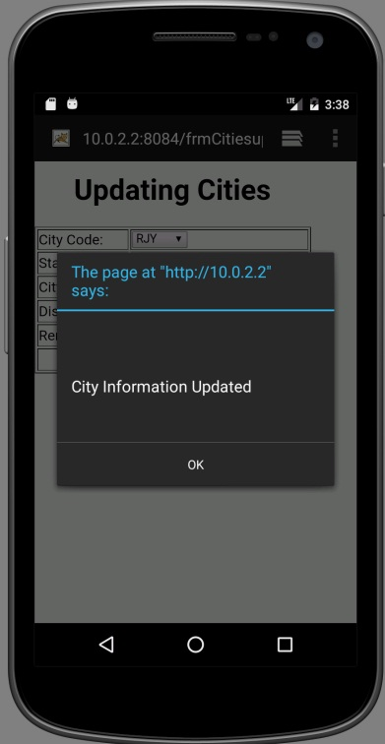
Data Update Form

Slide 30
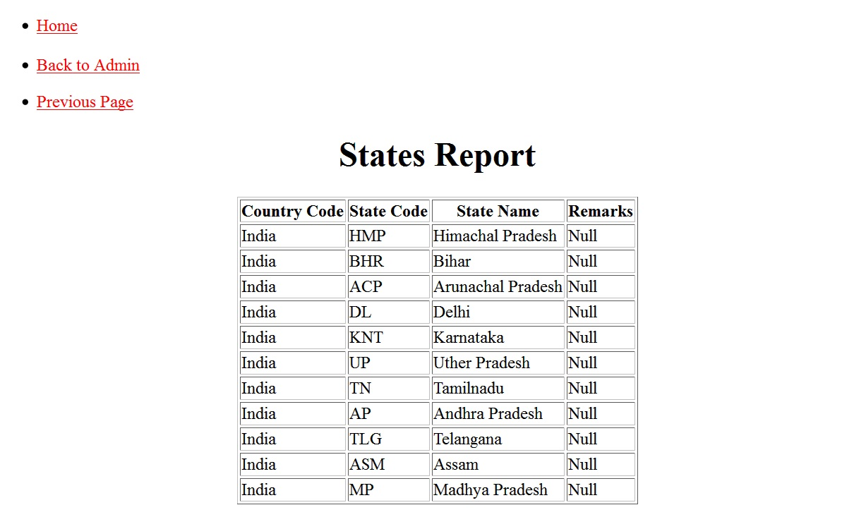
States Report

Slide 31
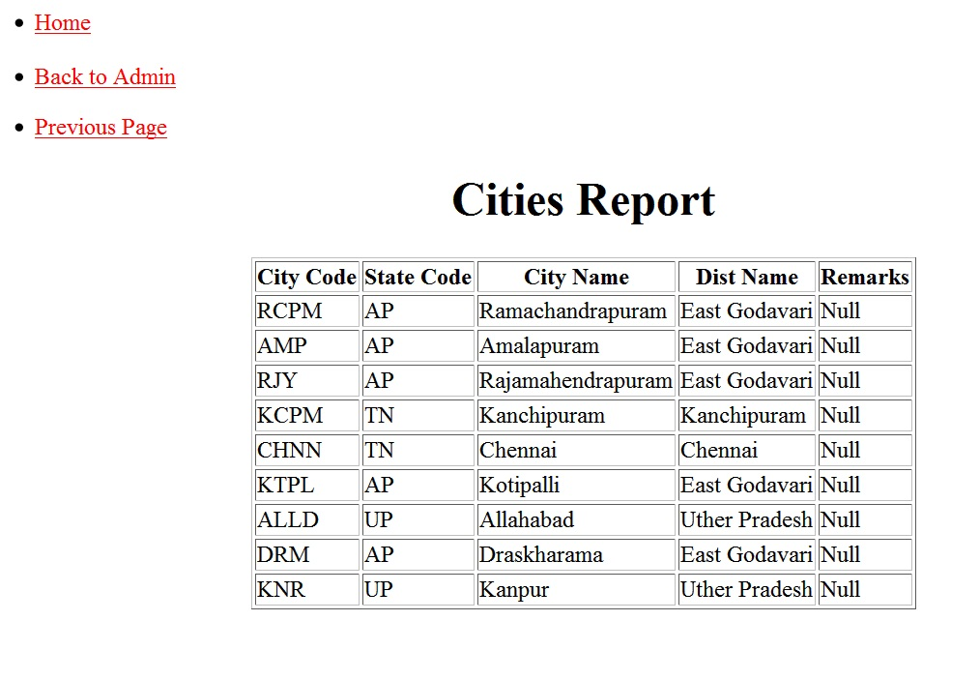
Cities Report

Slide 32
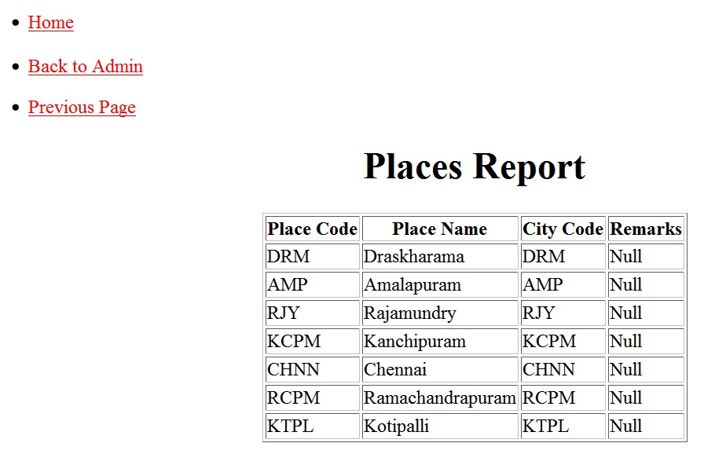
Places Report

Slide 33
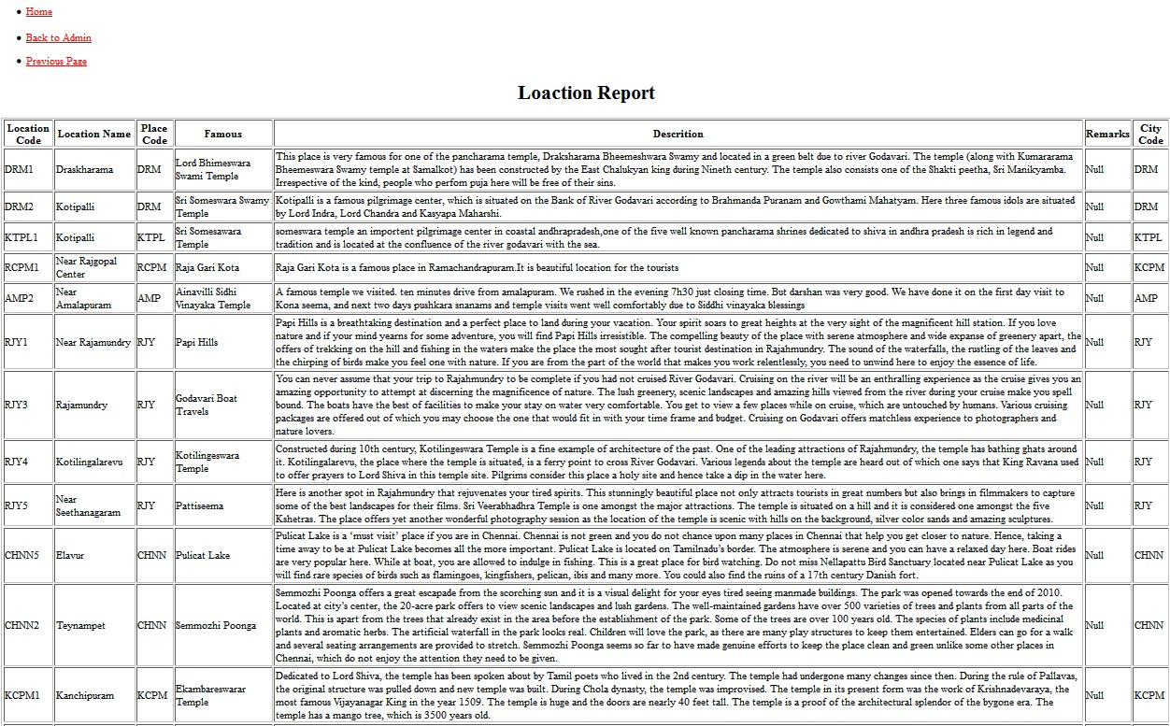
Location report

Slide 34
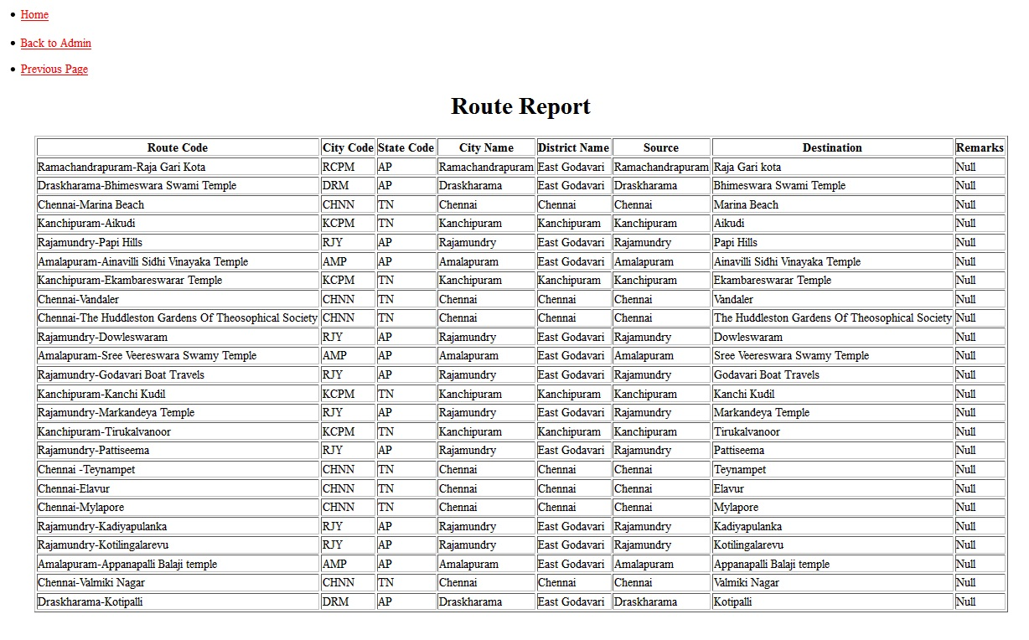
Route report

Slide 35
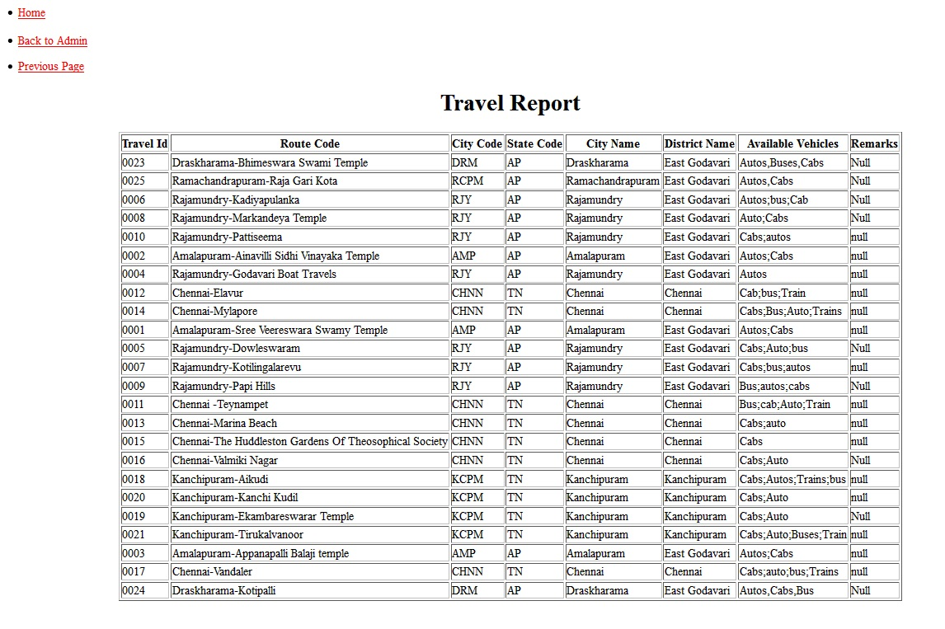
Travel report

Slide 36
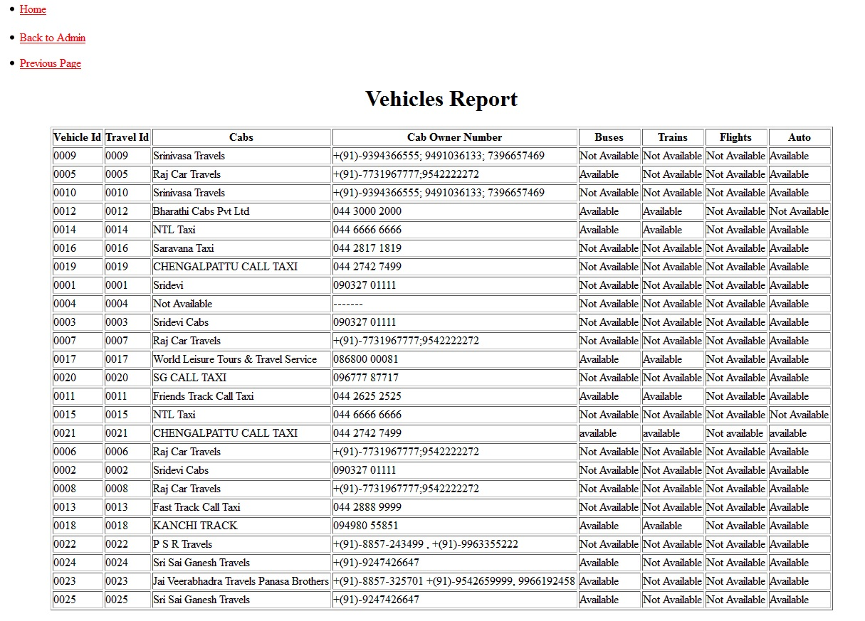
Vehicles report

Slide 37
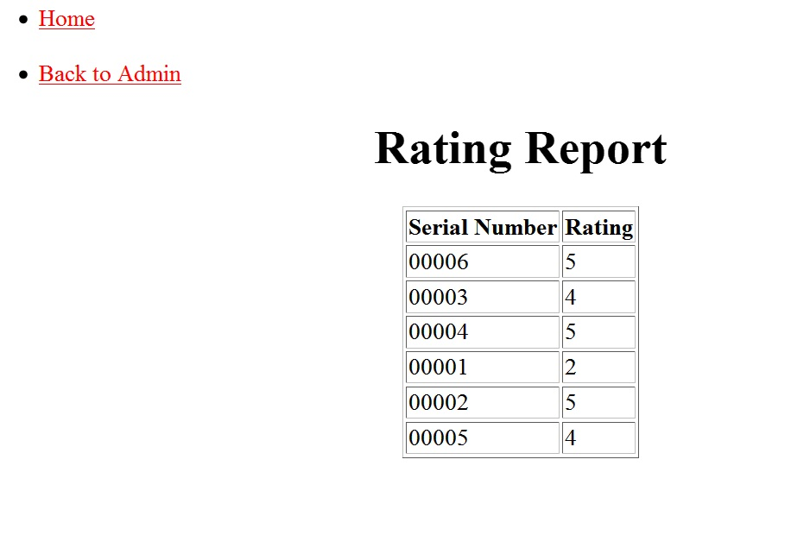
Rating report

Slide 38
HARDWARE REQUIREMENTS
Processor Type : Pentium IV
Memory (RAM) : 4GB
Hard Disk : 500GB
Drive : CD-ROM Drive
Display : 32-bit color Monitor
Modem Speed : 36KBPS

Slide 39
SOFTWARE REQUIREMENTS
Operating system : Microsoft Windows7.
Platform of development : Android studio
Database : Oracle10g
Web Browser : Internet Explorer 8.0
Front end : Android
Back end : My SQL,JSP
Web Server : Apache Tomcat 8.

Slide 40
CONCLUSION
This system provides the information query of Places, Routes, travels, Live Locations and so on. The system is a combination of Smart-phone and Internet to facilitate the tour of user.
The implementation of this project reduces the over expenditure of such companies and makes economical balance.
This project” Online City Tour Guide Application” is very helpful to the Tourists. The reports generated by this project are helpful to the Users.
This project is very user friendly, effective and efficient software.

Slide 41
THANK YOU

